Slide 1

Towards a pedagogy of love – key lessons in the move towards Education as Sustainability
Paul Warwick
paul.warwick@plymouth.ac.uk
Schools Meet Society - Urgent Sept 2020

Slide 2
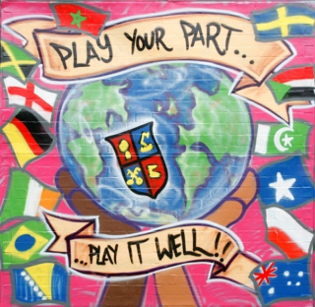
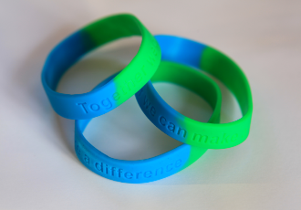
I’d like to risk being open with you
A lot of these insights have come from mistakes along the way
“I sometimes wonder how the world will be after 20 years. I personally think it will keep getting worse…… there probably will be numerous wars and there will be no life that exists on earth ……..the vast majority of communities don’t really improve over time. I think the world will be so horrible that people wouldn’t actually want to live in it and would rather die.”
14 year old pupil, Birmingham, UK

Slide 3
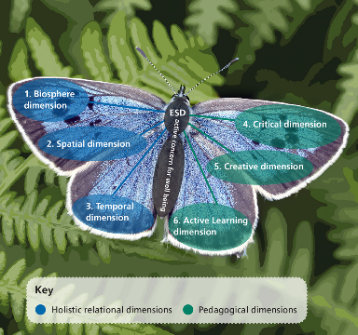

I’d like to risk starting a conversation about love with you
Transformative learning process centred on an
An active concern for the well being of:
People and other nature
Both locally and globally
Now and into the future
Education for Sustainable Development is about inspiring people to read their world in order to change it.
The butterfly model of Sustainable Education
Notes:
3

Slide 4
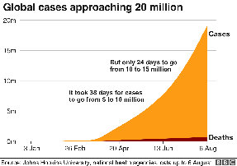
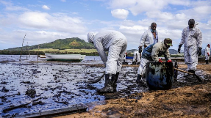
1. Sustainability Education needs to be in response to our pupils’ issues of concern
Young people are increasingly expressing
manifold interest in sustainability issues
Concerns at a Local Level | Concerns at a Global Level
Crime and violence | War and Terrorism
Community relations | Environmental problems
Lack of amenities | Hunger and poverty
Environmental problems | Social problems
Health risks | Crime and violence
Transport Problems | Diseases
Youth unemployment | Global Recession
Education | North/South Relations
Other | Other
Source: https://www.bbc.co.uk/newsround/53723524
Summary of young people’s main issues of concern N=415
Image source https://www.plymouthart.ac.uk/blog/news/plymouth-college-of-art-supports-the-global-climate-strikes

Slide 5
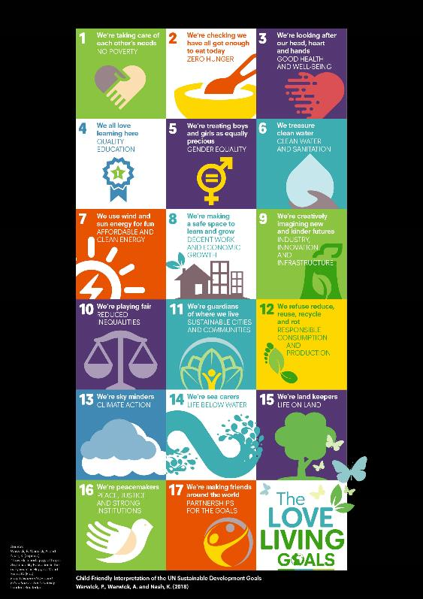
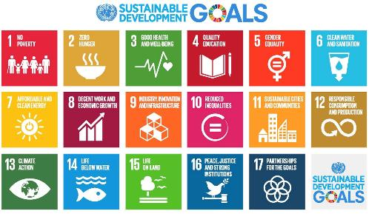
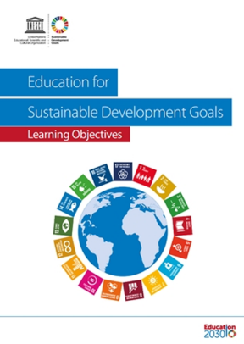
UNESCO (2017): Education for Sustainable Development Goals. Learning Objectives. Paris: UNESCO.
http://unesdoc.unesco.org/images/0024/002474/247444e.pdf
(Lead authors: Marco Rieckmann, Lisa Mindt, Senan Gardiner)

Slide 6

2. Sustainable Education is about repurposing education to be about the common good
‘Societies everywhere are undergoing deep transformation, and this calls for new forms of education to foster the competencies that societies and economies need, today and tomorrow.’
- Irina Bokova, UNESCO DG, 2015.
http://www.unesco.org/new/en/education/themes/leading-the-international-agenda/rethinking-education/

Slide 7
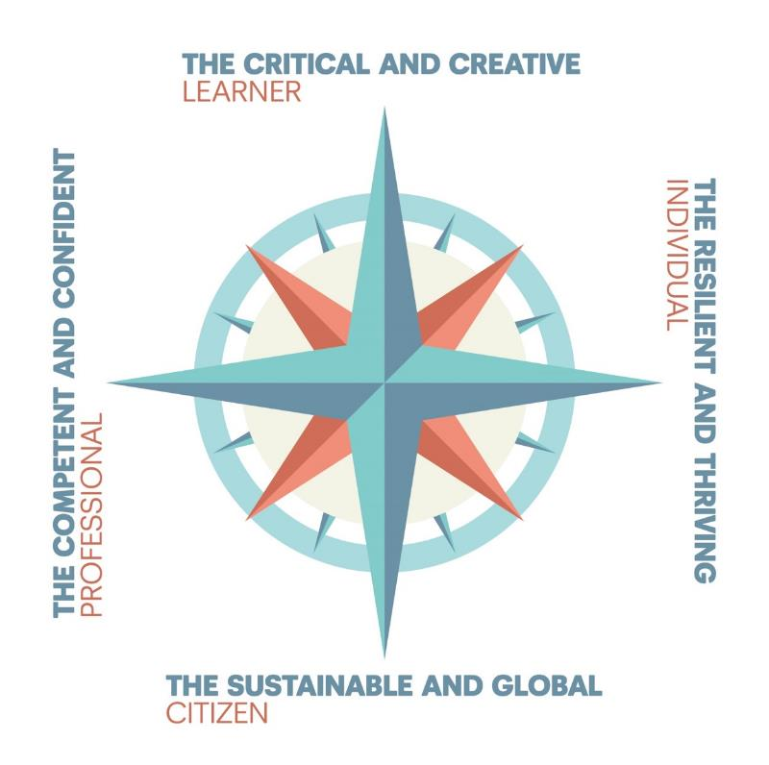

Slide 8
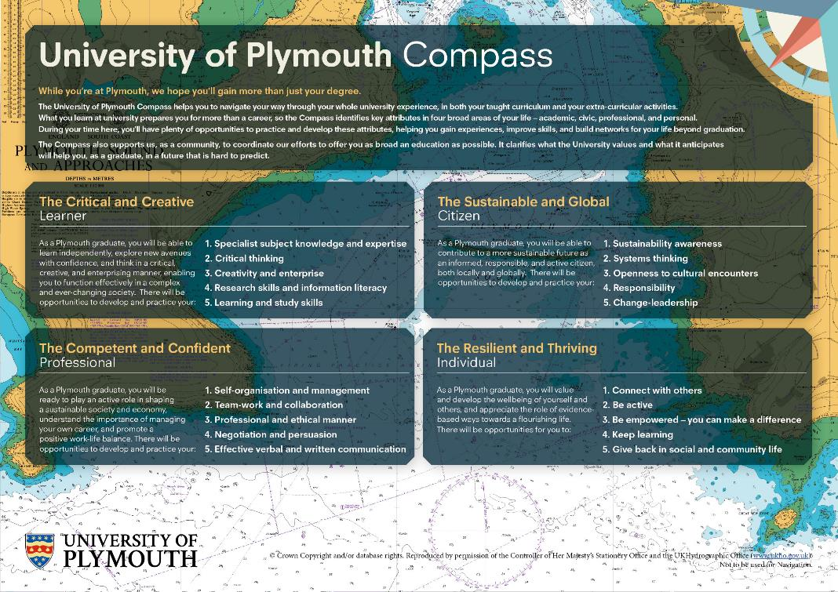
https://www.plymouth.ac.uk/about-us/teaching-and-learning/plymouth-compass

Slide 9
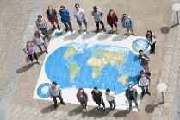
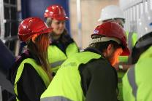
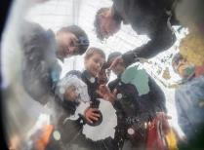

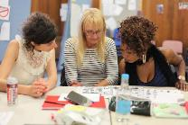
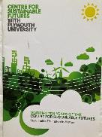
3. Sustainable Education is as much about pedagogy as it is content
Pedagogic research (e.g. UNESCO, 2012: 25–26) supports Sustainable Education being provided through participatory approaches:
Applied and active learning
Service Learning – Community Engaged Learning
Scenario based learning
Problem-based learning – action research
Role play, games and simulations
Open Space for Dialogue and Enquiry
Place based wild pedagogy

Slide 10
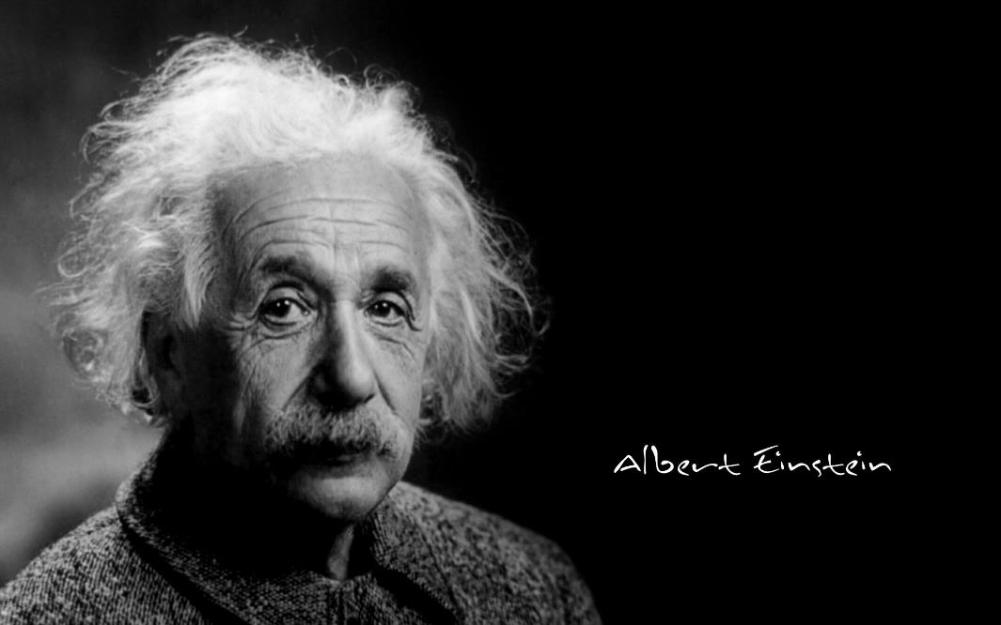
The world we have made as a result of the level of the thinking we have done thus far creates problems we cannot solve at the same level of thinking at which we created them.
4. Sustainable Education requires a movement towards a pedagogy of love

Slide 11
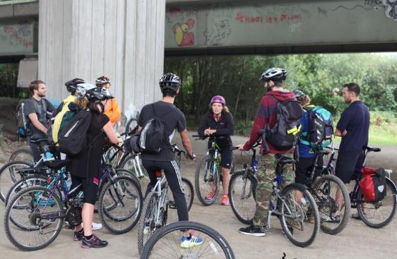
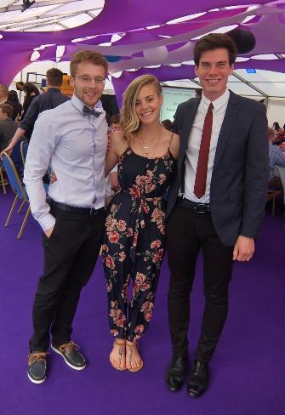
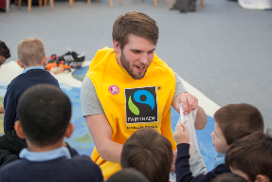
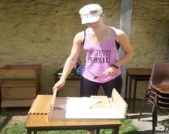
Developing students as compassionate critical creatives

Slide 12
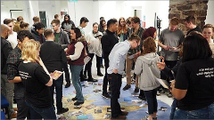
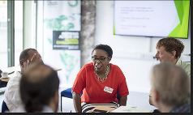
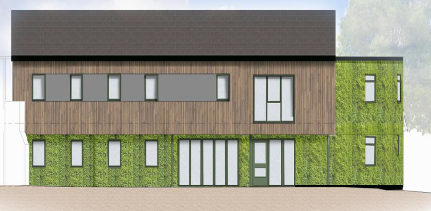
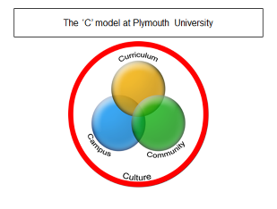
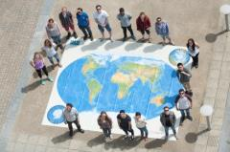
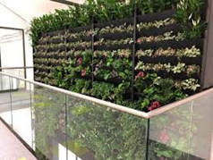

Creating sustainable futures together
The new Sustainability Hub on campus
In repsonse to students, staff, alumni and community partners the University has opened the Sustainability Hub (in Kirkby Lodge)
This new learning space on campus provides
A collaborative social learning space
Networking opportunities to support community engagement and service learning where students are able to make a difference through civic engagement at a local level
An incubation space for creative innovation in the curriculum, research, campus and public engagement work of this Univeristy.

Slide 13
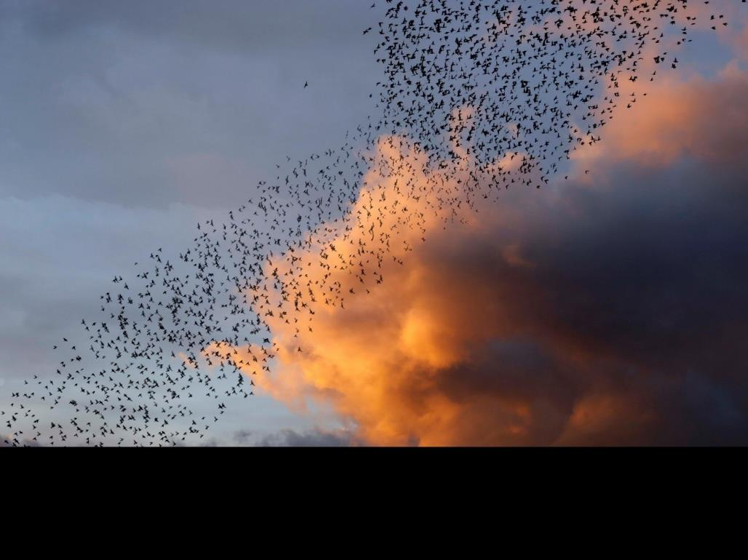
Moving away from the lone hero model of change
Image: Oliver Raymond Barker SEI Creative Associate University of Plymouth

